Slide 1
One-Way Hash Functions

Slide 2
Overview of One-way Hash Functions
Essential building block in cryptography
One-way and collision resistant properties
Usage example:
Password authentication
Integrity preservation
Blockchain
Possible Attacks:
Length extension attack
Collision attack

Slide 3
Properties of One-way Hash Function
Difference from Hash Function
Hash function: maps arbitrary size data to data of fixed size
Example: f(x) = x mod 1000
One-way Hash Properties:
One-way: hash(m) = h, difficult to find m
Collision resistant: Difficult to find m1 and m2 s.t. hash(m1) = hash(m2)
Common One-way Hash Functions:
MD series
SHA series

Slide 4
MD One-Way Hash Functions
MD stands for Message Digest
Developed by Ron Rivest
Includes MD2, MD4, MD5,and MD6
Status of Algorithms:
MD2, MD4 - severely broken (obsolete)
MD5 - collision resistance property broken, one-way property not broken
MD6 - developed in response to proposal by NIST

Slide 5
SHA
Published by NIST
Includes SHA-0, SHA-1, SHA-2, and SHA-3
Status of Algorithms:
SHA-0: withdrawn due to flaw
SHA-1: Designed by NSA; Collision attack found in 2017
SHA-2: Designed by NSA; Includes SHA-256 and SHA-512; Other truncated versions; No significant attack found yet
SHA-3: Released in 2015; Has different construction structure (compared to SHA-1 and SHA-2)

Slide 6
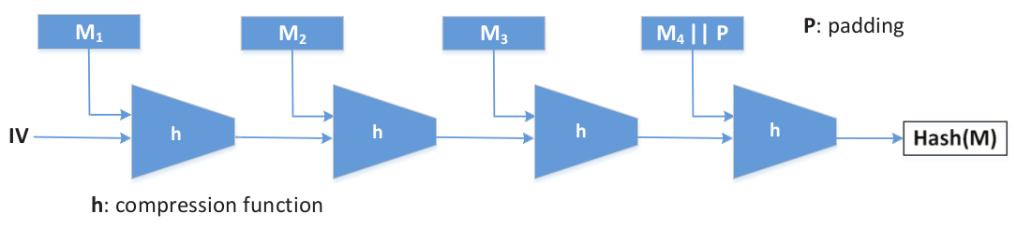
How One-Way Hash Algorithm Works
Construction method called Merkle–Damgard (Figure)
Used by algorithms like MD5, SHA-1, and SHA-2

Slide 7
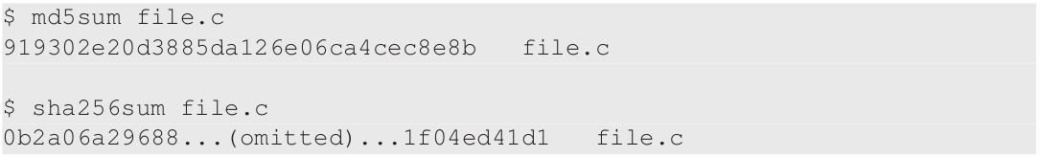
One-Way Hash Commands
Linux utility programs
Example: md5sum, sha224sum, sha256sum, sha384sum and sha512sum

Slide 8
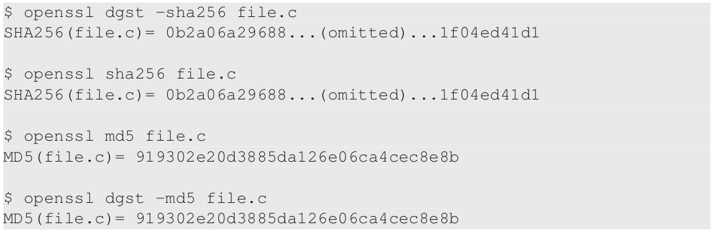
One-Way Hash Commands (Contd.)
Using openssl command to calculate hash

Slide 9
Computing One-Way Hash in Programs
Different languages including C/C++, Python, SQL, PHP provide support
Language specific:
MySQL - SHA2 function
Python - Use hashlib package
C - Use functions from openssl/sha.h header

Slide 10
Applications of One-Way Hash Functions
We will cover:
Integrity Verification
Committing a Secret Without Telling It
Password Verification
Trusted Timestamping

Slide 11
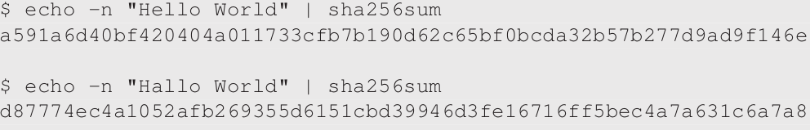
Integrity Verification
Changing one bit of the original data changes hash value
Usage examples:
Detect change in system files
Detect if file downloaded from website is corrupted

Slide 12
Committing a Secret Without Telling It
One-way property
Disclosing the hash does not disclose the original message
Useful to commit secret without disclosing the secret itself
Usage Example - Stock Market
Need to make prediction about the stock market about a certain day
Publish the hash of the secret on your website
On the particular day, release the secret
Your audience can verify it against the hash

Slide 13
Password Verification
To login into account, user needs to tell a secret (password)
Cannot store the secrets in their plaintext
Need for:
Password storage where nobody can know what the password is
If provided with a password, it verified against the stored password
Solution: one-way hash function
Example: Linux stores passwords in the /etc/shadow file

Slide 14
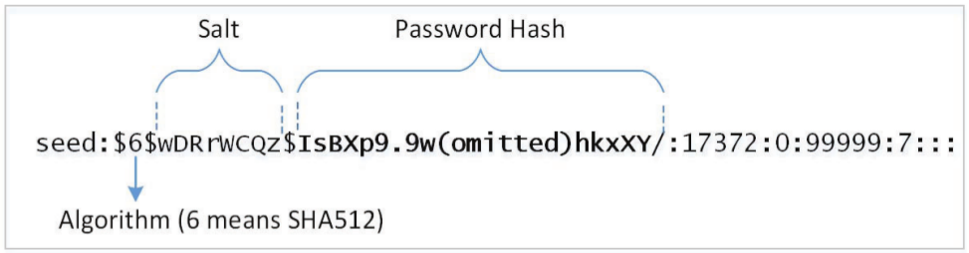
Case Study: Linux Shadow File
Password field has 3 parts: algorithm used, salt, password hash
Salt and password hash are encoded into printable characters
Multiple rounds of hash function (slow down brute-force attack)

Slide 15
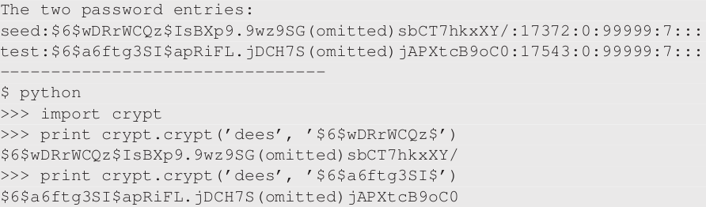
Purpose of Salt
Using salt, same input can result in different hashes
Password hash = one-way hash rounds (password || random string)
Random string is the salt

Slide 16
Attacks Prevented by Salt
Dictionary Attack
Put candidate words in a dictionary
Try each against the targeted password hash to find a match
Rainbow Table Attack
Precomputed table for reversing cryptographic hash functions
Why Salt Prevents them ?
If target password is same as precomputed data, the hash will be the same
If this property does not hold, all the precomputed data are useless
Salt destroys that property

Slide 17
Trusted Timestamping
Need: How to prove that a document existed prior to certain date ?
Timestamping Approaches:
Approach # 1: Publish one-way hash (instead of document) in a newspaper or a magazine
Approach # 2: Time Stamping Authority (TSA) can sign the document hash using private key
Approach # 3:
Use Blockchain i.e. a growing list of record (blocks)
Publish document hash in a block
Blockchain depends on one-way hash

Slide 18
Message Authentication Code (MAC)
Network communication can encounter MITM attacks
MITM can intercept and modify data
Receiver needs to verify integrity of data
Attach tag to data
Using one-way hash as tag won’t work because MITM can recompute hash
Use a shared secret (key) between sender and receiver in the hash
MITM cannot compute hash without secret key

Slide 19
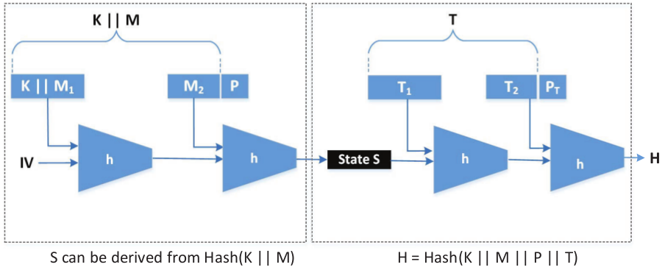
Length Extension Attack on MAC
Key and message need to be mixed properly before computing hash
Simple concatenation (K || M) does not work

Slide 20
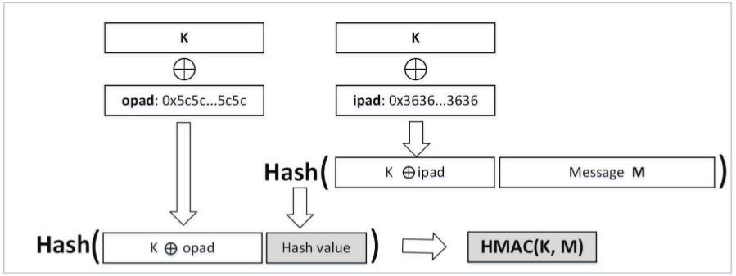
Keyed-Hash MAC (HMAC)
Uses hash function H (compression function block size B) and a secret key K
ipad = 0x36 (B times), opad = 0x5c (B times)
Can be used with any one-way hash function

Slide 21
Blockchain and Bitcoins
Continuously growing list of records, called blocks
Managed by ledgers in a peer-to-peer network
Accepted ledger block is difficult to modify because it requires alteration of all subsequent blocks
Popular application is Bitcoin
We will cover:
Hash Chain and Blockchain
Make Chaining Difficult
Adding Incentives and Bitcoin

Slide 22
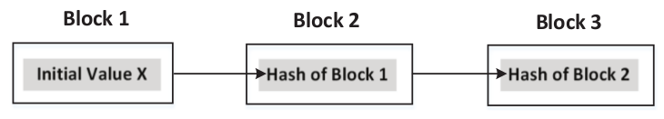
Hash Chain
Successive application of a one-way hash function to a piece of data
If a block gets modified, it will fall off from the chain, and will not be considered as part of the chain
If original data is changed, then the entire chain needs to be regenerated

Slide 23
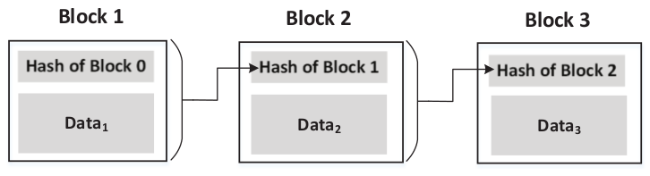
Blockchain
Similar to hash chain, but has additional information in each block
Bitcoin example: information about bitcoin transactions in blocks
Create Chain: Hash value of a block is inside the next block
If one block is modified:
All the chains after this block are broken
Require need to re-chain all the subsequent blocks

Slide 24
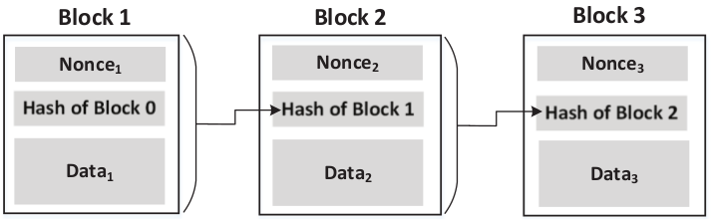
Blockchain: Make Chaining Difficult
Nonce is added to each block
Block hash must satisfy requirement (e.g. 20 leading zeros)
Since computation power will increase over time, number of leading zeros is intentionally increased over time

Slide 25
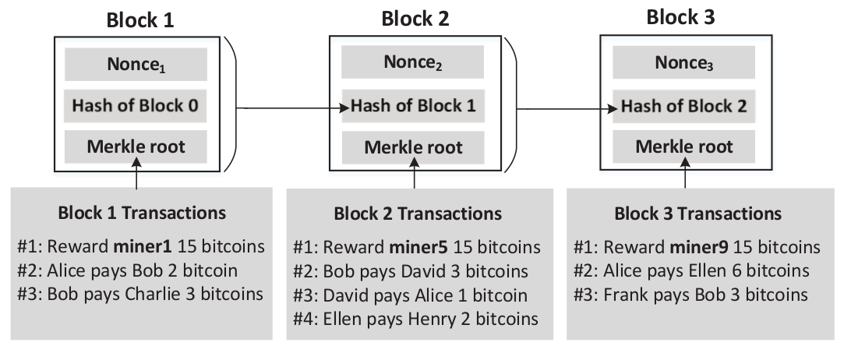
Blockchain Incentives and Bitcoin
Provide bitcoins to anyone who can find nonce to chain blocks
Companies / individuals who search for the nonce are “miners”

Slide 26
Hash Collision Attacks
Popular one-way hash functions have trouble maintaining the collision-resistance property
We will cover:
Security Impact of Collision Attacks
Generating Two Different Files with the Same MD5 Hash
Generating Two Programs with the Same MD5 Hash

Slide 27
Security Impact of Collision Attacks
Forging public-key certificates
Assume two certificate requests for www.example.com and www.attacker.com have same hash due to collision
CA signing of either request would be equivalent
Attacker can get certificate signed for www.example.com without owning it
Integrity of Programs
Ask CA to sign a legitimate program’s hash
Attacker creates a malicious program with same hash
The certificate for legitimate program is also valid for malicious version
These two examples are theoretical with questionable feasibility

Slide 28
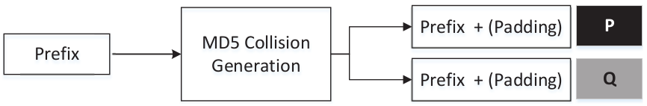
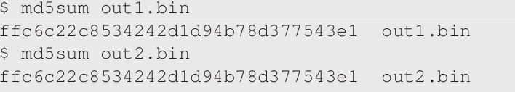
Generating Two Different Files with the Same MD5 Hash
md5collgen tool generates two files with same prefix

Slide 29
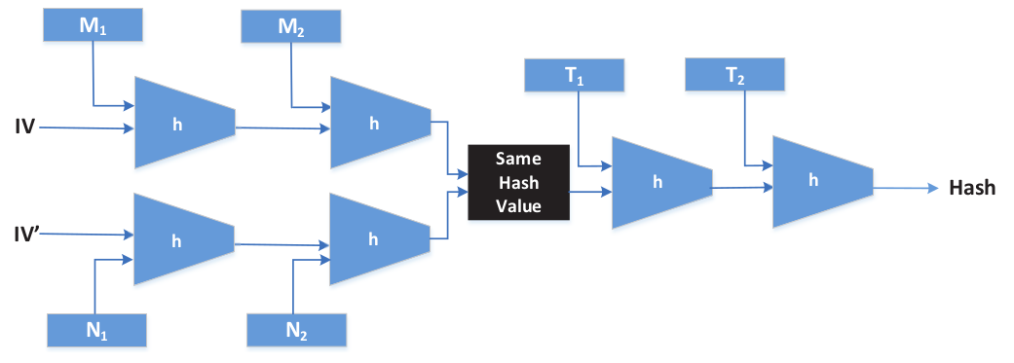
Length Extension
Generate two files with same prefix and same suffix
Focus on MD5, SHA-1, SHA-2 using Merkle-Damgard construction
If Hash (M) = Hash (N), then for any input T, Hash (M || T) = Hash (N || T)

Slide 30
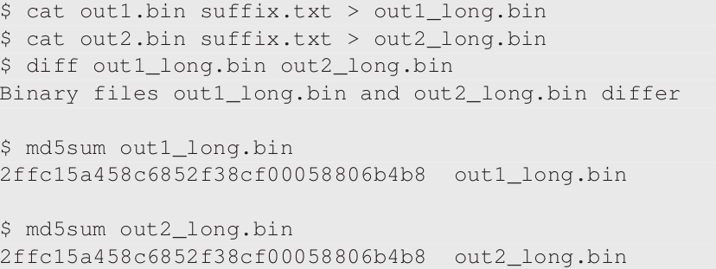
Length Extension (Contd.)
Example using out1.bin and out2.bin generated by md5collgen

Slide 31
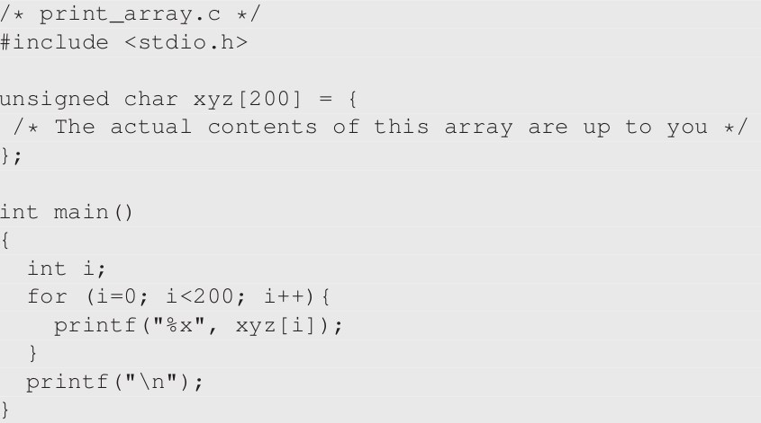
Generating Two Programs with the Same MD5 Hash
Create two versions of program below with different value for xyz

Slide 32
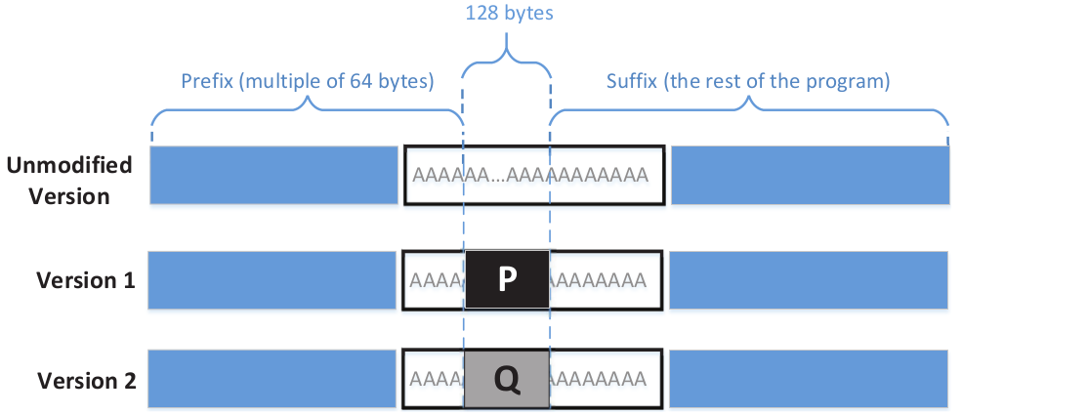
Two Programs with Same Hash (Contd.)
Program will be compiled into binary (fill xyz with fixed value)
Portion of binary containing xyz will be divided into three parts

Slide 33
Two Programs with Same Hash (Contd.)
Use md5collgen on prefix:
generate two files with same hash
last 128 bit of each generated file is P and Q
MD5 (prefix || P) = MD5 (prefix || Q)
MD5 (prefix || P || suffix) = MD5 (prefix || Q || suffix)

Slide 34

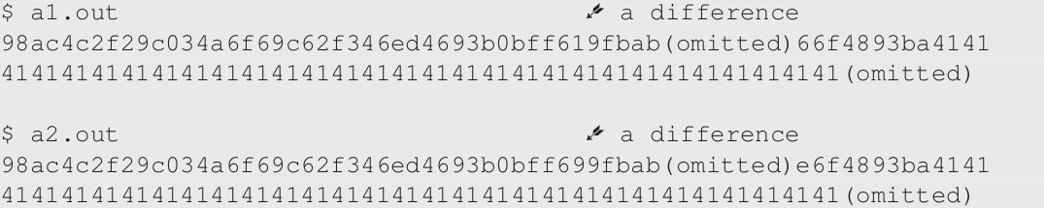
Two Programs with Same Hash (Contd.)

Slide 35
Summary
One-way hash function is an essential building block in cryptography
Important Properties: One-way and Collision resistant
Applications
Password authentication
Trusted Timestamping
Blockchain and Bitcoin
MAC used to preserve integrity of communication
One-way hash are subject to length extension and collision attacks

